Slide 1
BuyMe
ALX-FINAL PROJECT PRESENTATION

Slide 2
Table of Content:
1-Introduction | Brief description of the project // The team members
2-Architecture & Technologies | Breakdown of the project architecture and technologies
3-Development Report | Successes // Challenges // Areas for improvement // Lessons learned // Next steps for the project
4-App Overview
5-Conclusion | Summary of the project experience
6-Acknowledgement and special thanks to ALX | Acknowledgement and special thanks to ALX
For more info:
You can visit our project repository: https://github.com/watch14/E-Com-Project-Back-end

Slide 3
01
Introduction

Slide 4
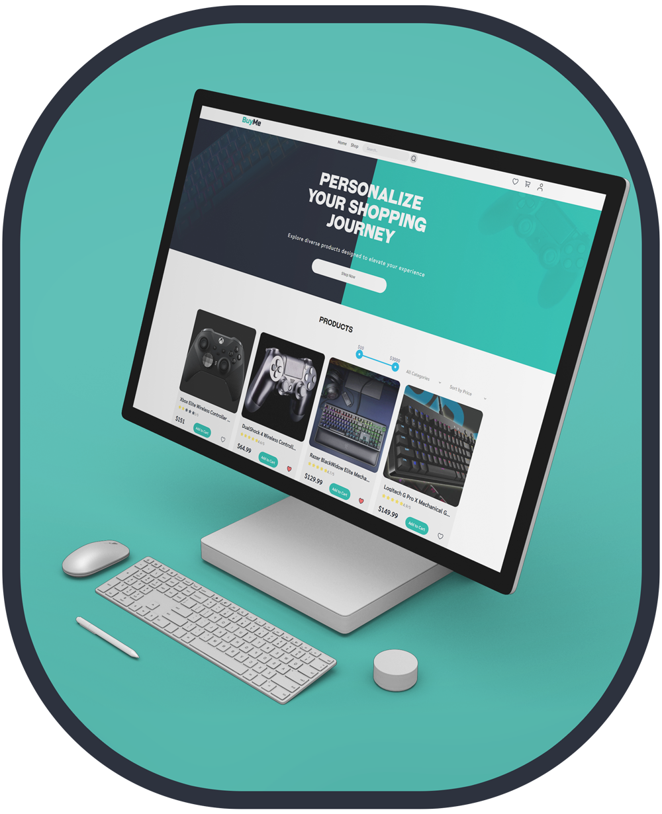
Introduction
BuyMe is an e-commerce platform dedicated to gamers and tech enthusiasts. Our website specializes in offering a wide range of gaming materials, including keyboards, mice, monitors, and PCs. Designed with a user-friendly interface, BuyMe aims to provide a seamless shopping experience for all gaming needs.

Slide 5
Introduction of the Team Members
Maamoun Chebbi
Iheb Chaoued
Seif Eddine Ben Othman
Build APIs, manage authentication, and implement error handling.
Design schemas, handle CRUD operations and ensure data integrity.
Develop components, integrate APIs, ensure responsive design.

Slide 6
02
Architecture
&
Technologies

Slide 7
Overview of the Project Architecture and Technologies Used:
Frontend: Angular
Backend: Node.js with Express
Database: MongoDB
• Angular: For building the dynamic and responsive user interface.
• TypeScript: Enhances code quality.
• HTML and CSS: For structuring and styling web pages.
• RESTful API: The backend is built using Node.js and Express, providing a robust RESTful API for handling client requests. Node.js: Enables high-performance server-side applications.
• MongoDB: Known for its flexibility and scalability.
File Storage: Firebase
Payment Gateway Integration
Development Tools
• Reliable storage: Firebase is used for storing product images.
• Stripe: Handle secure online transactions.
• Visual Studio Code: A source-code editor for writing and editing the codebase.
• Postman: For testing and debugging API endpoints.
• Swagger: For designing, building, and documenting RESTful APIs.

Slide 8
03
Development Report

Slide 9
Successes:
Challenges:
Lessons Learned:
User-Friendly Interface
Robust Backend
Efficient Data Management
Successfully implemented a responsive and intuitive user interface using Angular, ensuring a seamless shopping experience across various devices.
Developed a reliable RESTful API using Node.js and Express, providing efficient handling of client requests.
Employed MongoDB with Mongoose for flexible and scalable data storage and management.
Complex Data Relationships
Effective Collaboration and Agile Development
Managing relationships between data entities in MongoDB was challenging, but a lot of schema validation helped ensure data consistency.
Emphasized the importance of communication and collaboration within the team, leveraging agile methodologies for efficient development and iterative improvements.

Slide 10
04
App Overview

Slide 11
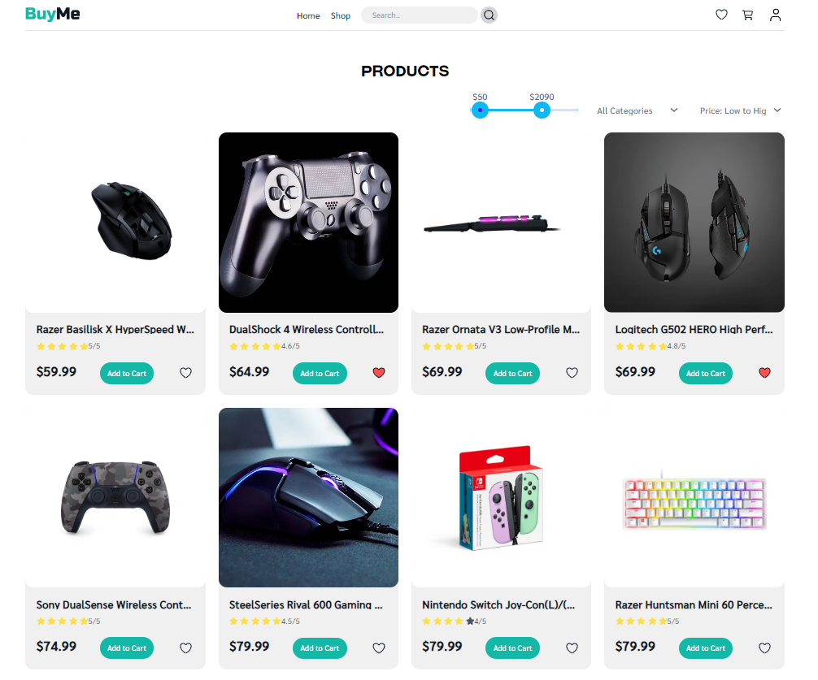
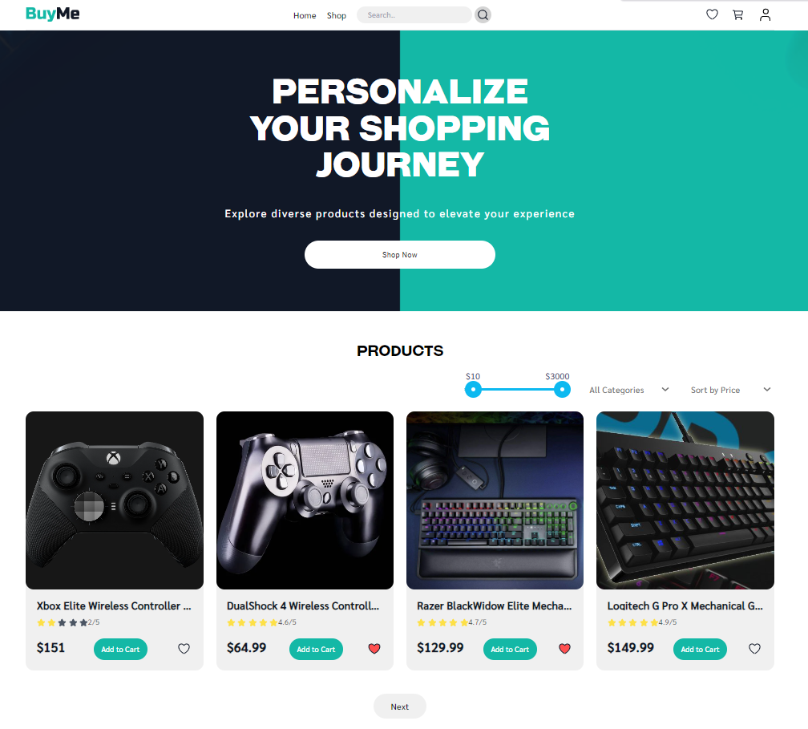
Home Page
Shop Page

Slide 12
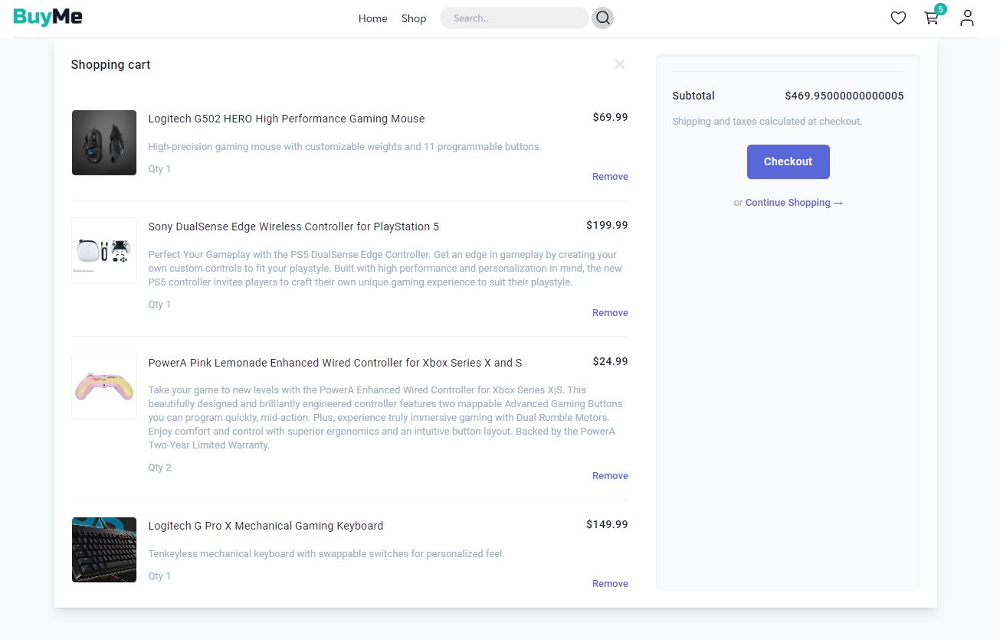
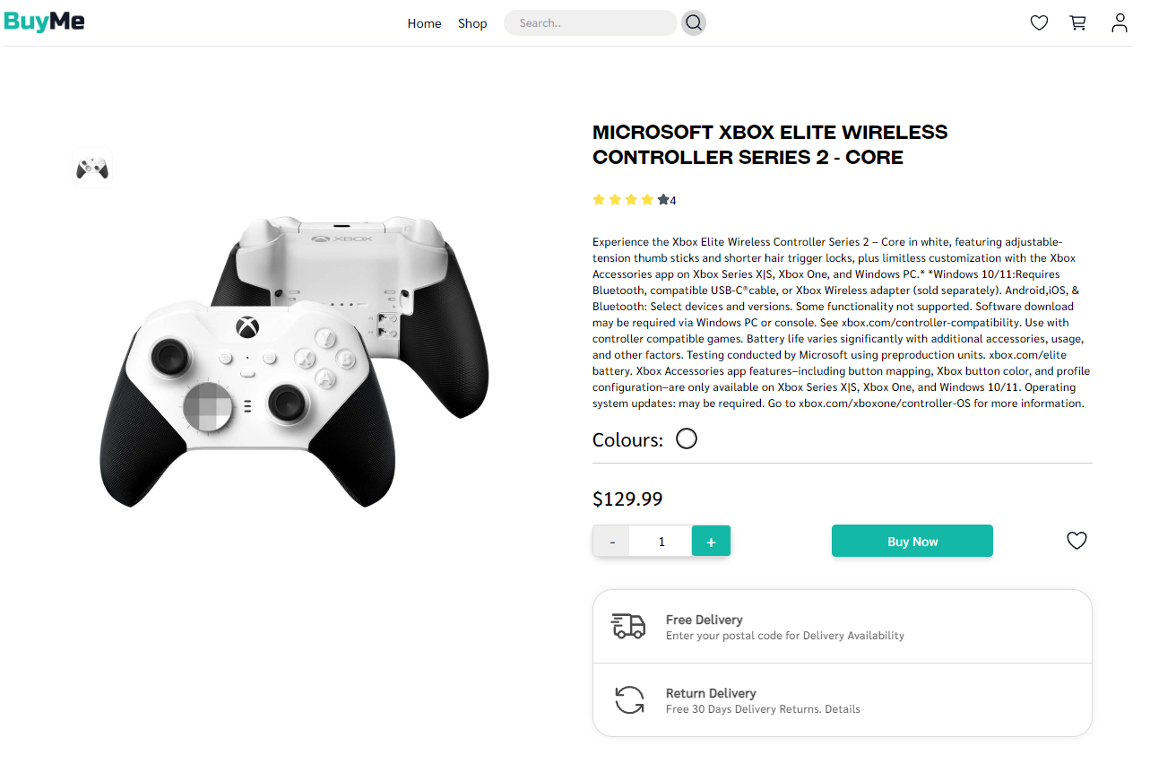
Product Page
Cart Page
Home Page

Slide 13
05
Conclusion

Slide 14
Conclusion
Developing BuyMe was rewarding and challenging. Using Angular, Node.js, Express, MongoDB, and Firebase, we built a user-friendly e-commerce platform for gaming materials. We overcame data management and performance issues through teamwork and agile methods.
We learned the importance of continuous learning and team communication.
BuyMe improved our technical skills and showed the value of teamwork in software development.

Slide 15
06
Special Thanks

Slide 16
Special Thanks to ALX
We would like to extend our heartfelt thanks to ALX for providing us with this incredible learning opportunity. The guidance, resources and support from ALX have been invaluable in the successful completion of our BuyMe project. This experience has significantly contributed to our growth as developers and has prepared us for future challenges in our careers.
Thank You :)

